Slide 1
Operators in Python
- By
Hemlata Kohin

Slide 2
Today’s Objectives
• To learn Python’s operators
–Arithmetic operators
–Assignment operators
–Comparison operators
–Boolean operators
– Logical operators

Slide 3
Which of the following examples are correct?
500 = numStudents
numStudents = 500
3. numCookies * cookiePrice = total
4. mpg = miles_driven / gallons_used
5. "Hello World!" = message
6. _CMSC201_doge_ = "Very learning"
7. 60 * hours = days * 24 * 60

Slide 4
Python Basic Operators
• Operatorsare the constructs which can manipulate and evaluate our data
Consider the expression:
num = 4 + 5
Operator

Slide 5
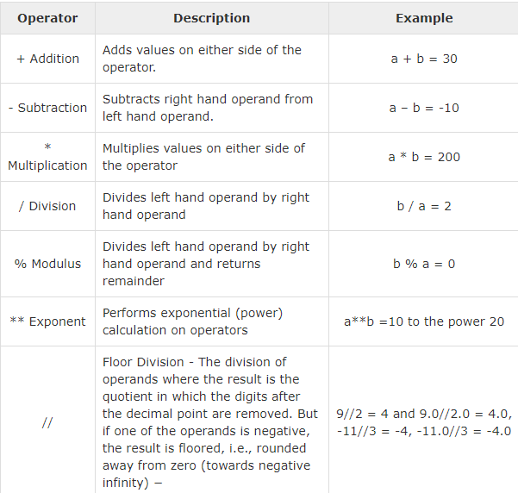

Slide 6
Some Examples
a. (5 + 7) / 2
b. ( ((2 + 4) * 5) / (9 - 6)
c. tax = subtotal * 0.06
d. area = PI * (radius * radius)
e. totalDays = hours / 24

Slide 7
Some More Examples
Examples: Integer Division
Integer division uses double slashes (//)
7 / 5 = 1.4
7 // 5 = 1
2 / 8 = 0.25
2 // 8 = 0

Slide 8
Examples : Modular
Also called Mod.
Gives out only the remainder
17 % 5 = 2
16 % 3= 1
20 % 9= 2
48692451673 % 2 = 1

Slide 9
Operators –Exponentiation
“Exponentiation” is just another word for raising one number to the power of another
Examples:
1. binary8 = 2 ** 8
2. squareArea = length ** 2
3. cubeVolume = length ** 3
4. squareRoot = num ** 0.5

Slide 10
Assignment Operators

Slide 11
Basic Assignment
• All assignment operators
–Contain a single equal sign
–Must have a variable on the left side
• Examples:
numDogs = 18
totalTax = income * taxBracket
numPizzas = (people // 4) + 1

Slide 12
Combining with Arithmetic
– You can simplify statements like these
count = count + 1 doubling = doubling * 2
doubling = doubling * 2
–By combining the arithmetic and assignment
count += 1
doubling *= 2
– This is called short hand notation
– You can do this with any arithmetic operator

Slide 13
Short Hand Notation
These shortcuts assume that the variable is the firstthing after the assignment operator
percent = int(input("Enter percent: "))
# convert the percentage to a decimal percent /= 100
The last line is the same as this line
percent = percent / 100

Slide 14
Exercise with Short Hand Notations
money_in_wallet = 40
sandwich_price = 7.50
sales_tax = .08 * sandwich_price
sandwich_price += sales_tax
money_in_wallet -= sandwich_price

Slide 15
Comparison Operators

Slide 16
Overview
Comparison operators
Relational operators
Equality operators
–Are all the same thing
Include things like >, >=, <, <=, ==, !=

Slide 17
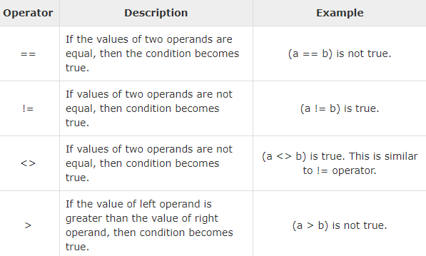
Comparison Operators

Slide 18
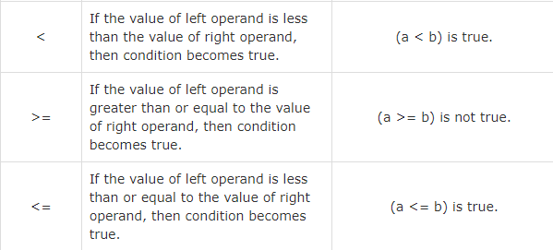
Comparison Operators

Slide 19
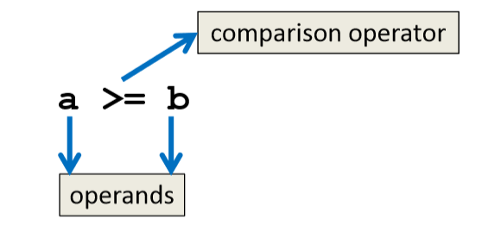
Comparison Operators
Always return a Boolean result
–True or False
–Indicates whether a relationship holds between their operands

Slide 20
Comparison Examples
What are the following comparisons asking
a >= b
–Is a greater than or equal to b?
a == b
–Is a equivalent to b?

Slide 21
Comparison Examples (Continued)
• What do these evaluate to
if a = 10 and b = 20?
a <= b
–Is a less than or equal to b?
–Is 10 less than or equal to 20?
–True

Slide 22
Comparison Examples (Continued)
• What do these evaluate to if
a = 10 and b = 20?
a == b
–Is a equivalent to b?
–Is 10 equivalent to 20?
–False

Slide 23
Comparison vs Assignment
A common mistake is to use the assignment operator (=) in place of the relational (==)
–This is a very common mistake to make!
• This type of mistake will trigger an error in Python

Slide 24
Equals vs Equivalence
• What does a = b do?
–Assigns a the value stored in b
–Changes a’s value to the value of b
• What does a == b do?
–Checks if a is equivalent to b
–Does not change the value of a or b

Slide 25
Evaluating to Boolean Values

Slide 26
Comparison Operators and Simple Data Types
Examples:
8 < 15 evaluates to True
6 != 6 evaluates to False
2.5 > 5.8 evaluates to False
4.0 == 4 evaluates to True

Slide 27
“Value” of Boolean Variables
• When we discuss Boolean outputs, we use
True and False
• We can also think of it in terms of
1 and 0
• True = 1
• False = 0

Slide 28
“Value” of Boolean Variables
• Other data types can also be seen as
“True” or “False” in Python
• Anything empty or zero is False
– " "(empty string), 0, 0.0
• Everything else is True
–81.3, 77, -5, "zero", 0.01
–Even "0" and "False" evaluate to True

Slide 29
Logical Operators

Slide 30
Logical Operators
There are three logical operators:
–and
–or
–not

Slide 31
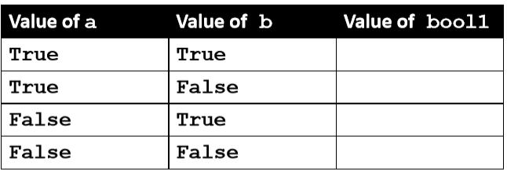
Logical Operators –and
Let’s evaluate this expression
bool1 = a and b
For a and b to be True, both a and b must be true

Slide 32
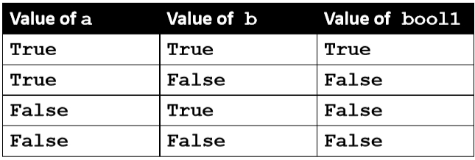
Logical Operators –and
Let’s evaluate this expression
bool1 = a and b
For a and b to be True, both a and b must be true

Slide 33
Exercise – And
a = 10, b = 20, c = 30
ex1 = a < b
ex2 = a < b and b < c
ex3 = (a + b == c) and (b – 10 == a) and (c / 3 == a)
print (ex1, ex2, ex3)
What is the output?

Slide 34
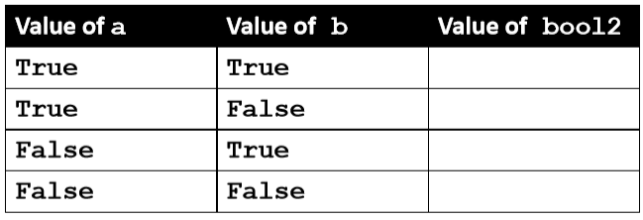
Logical Operators –or
Let’s evaluate this expression
bool2 = a or b
For a or b to be True, either a or b must be true

Slide 35
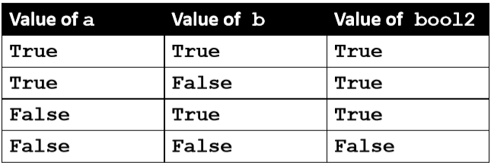
Logical Operators –or
Let’s evaluate this expression
bool2 = a or b
For a or b to be True, either a or b must be true

Slide 36
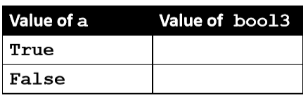
Logical Operators –not
Let’s evaluate this expression
bool3 = not a
not a calculates the Boolean value of a and returns the opposite of that

Slide 37
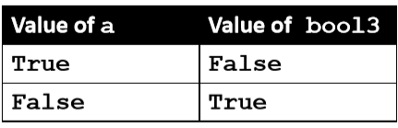
Logical Operators –not
Let’s evaluate this expression
bool3 = not a
not a calculates the Boolean value of aand returns the opposite of that

Slide 38
Complex Expressions
We can put multiple operators together!
bool4 = a and (b or c)
What does Python do first?
–Computes (b or c)
–Then computes a and the result

Slide 39
Practice with Comparisons
a = 10, b = 20, c = 30
bool1 = True and (a > b)
bool2 = (not True) or (b != c)
bool3 = (True and (not False)) or (a > b)
bool4 = (a % b == 2) and ((not True) or False)
print (bool1, bool2, bool3, bool4)

Slide 40
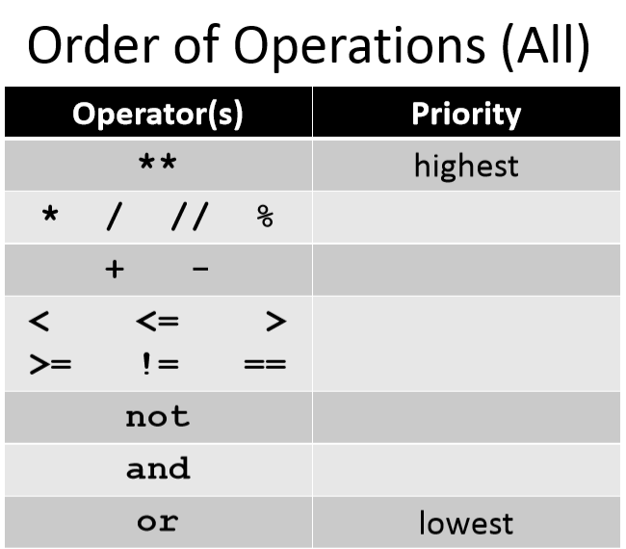

Slide 41
Any Questions?

